Slide 1

Design Patterns
solutions to known problems

Slide 2
"Each pattern describes a problem that occurs over and over again in our environment, and then describes the core of the solution to that problem, in such a way that you can use this solution a million times over, without ever doing it the same way twice." - Christopher Alexander, A Pattern Language.
https://github.com/vesou/PatternsDemo

Slide 3
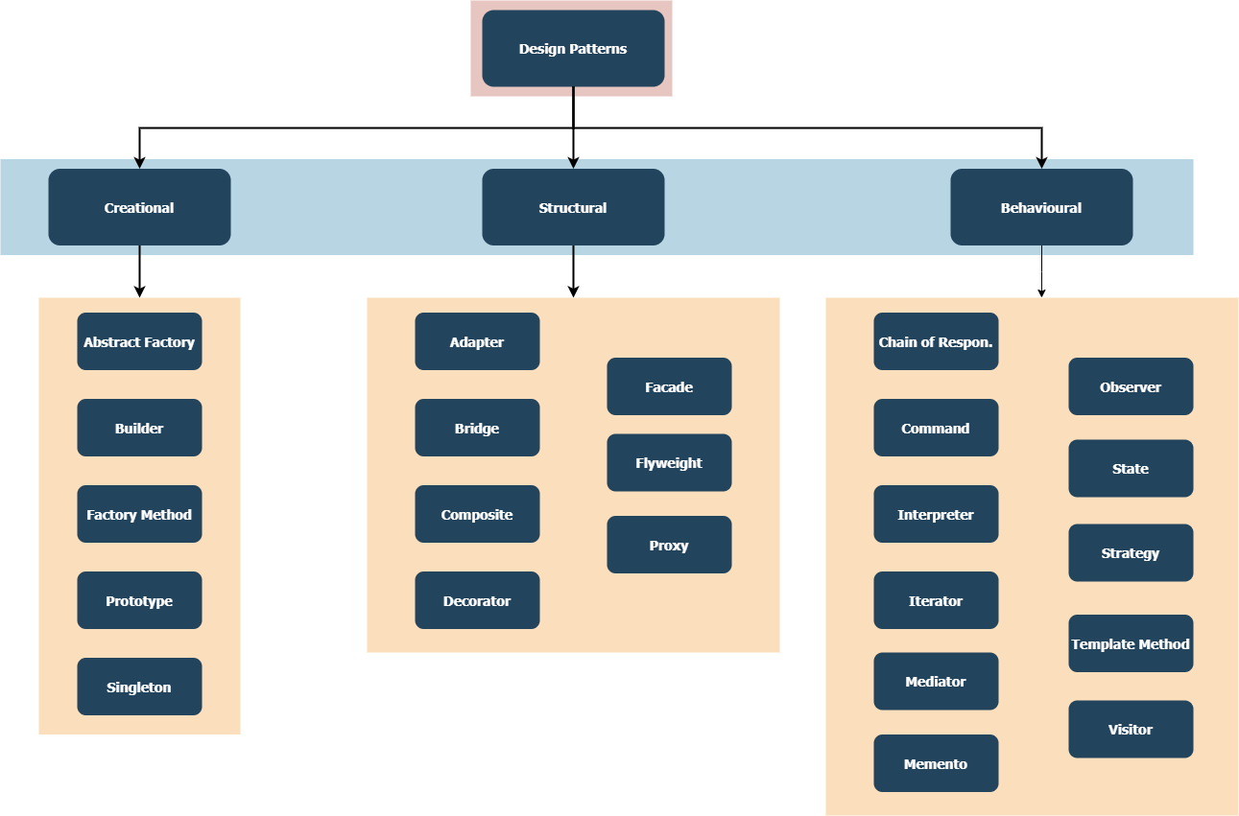
Notes:
Creational Design Pattern (object creation and initialization)
Structural Design Pattern (Structural Changes of class and interfaces, and the relationship between classes)
Behavioral Design Pattern (Communication Between Objects changing object behaviour)
Many different patterns exist – like in Event Driven Architecture: Idempotent Consumers, Event Choreography, Orchestration

Slide 4
Basics
Interfaces – a way of decoupling implementations
Inheritance – common logic for a group of classes
Polymorphism – ability to treat all types as their parent
Abstract classes – theoretical class implementation
Abstraction – limiting interface to only important things
Encapsulation – hiding inner workings of the implementation

Slide 5
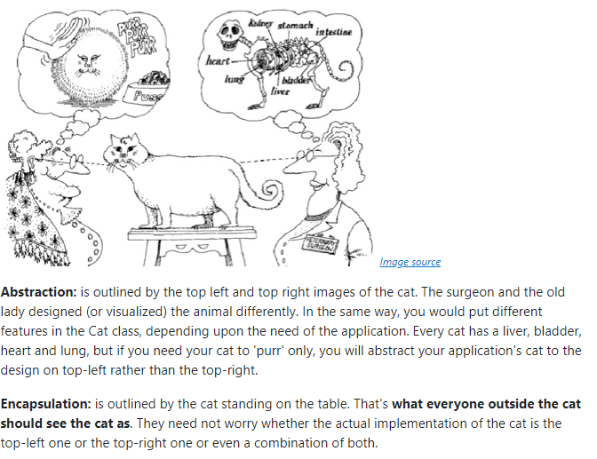
Abstraction vs Encapsulation
https://stackoverflow.com/questions/16938667/how-abstraction-and-encapsulation-differ

Slide 6
Creational Patterns
Singleton - A class of which only a single instance can exist
Prototype - A fully initialized instance to be copied or cloned
Builder - Separates object construction from its representation
Factory Method - Creates an instance of several derived classes
Abstract Factory - Creates an instance of several families of classes
Notes:
Factory method - design pattern defines an interface for creating an object, but let subclasses decide which class to instantiate. This pattern lets a class defer instantiation to subclasses. Each concreate implementation has it’s own method to create object
Abstract factory – a class has a concrete implementation picked and it has multiple methods to create objects, but it will use that specified implementation, chair sofa + table in different types art deco, Victorian, modern

Slide 7
Structural Patterns
Adapter - Match interfaces of different classes – map methods
Bridge - Separates an object’s interface from its implementation
Facade - A single class that represents an entire subsystem
Proxy - An object representing another object
Composite - A tree structure of simple and composite objects
Decorator - Add responsibilities to objects dynamically
Flyweight - A set of reusable fine-grained instances used for efficient sharing
Notes:
Adapter - design pattern converts the interface of a class into another interface clients expect. This design pattern lets classes work together that couldn‘t otherwise because of incompatible interfaces.
Facade - design pattern provides a unified interface to a set of interfaces in a subsystem. This pattern defines a higher-level interface that makes the subsystem easier to use.
Proxy - design pattern provides a surrogate or placeholder for another object to control access to it.
Composite – This pattern lets clients treat individual objects and compositions of objects uniformly. A list of commands that can be made of more commands.

Slide 8
Behavioural Patterns
Chain of Resp. - A way of passing a request between a chain of objects
Command - Encapsulate a command request as an object
Interpreter - A way to include language elements in a program
Iterator - Sequentially access the elements of a collection
Mediator - Defines simplified communication between classes
Memento - Capture and restore an object's internal state
Observer - A way of notifying change to a number of classes
State - Alter an object's behaviour when its state changes
Strategy - Encapsulates an algorithm inside a class
Template Method - Defer the exact steps of an algorithm to a subclass
Visitor - Defines a new operation to a class without change
Notes:
The Chain of Responsibility design pattern avoids coupling the sender of a request to its receiver by giving more than one object a chance to handle the request. This pattern chains the receiving objects and passes the request along the chain until an object handles it.
The Command design pattern encapsulates a request as an object, thereby letting you parameterize clients with different requests, queue or log requests, and support undoable operations.
The Memento design pattern without violating encapsulation, captures and externalizes an object‘s internal state so that the object can be restored to this state later.
The Observer design pattern defines a one-to-many dependency between objects so that when one object changes state, all its dependents are notified and updated automatically.
The State design pattern allows an object to alter its behaviour when its internal state changes. The object will appear to change its class.
Visitor – mix between template method and decorator

Slide 9
Decorator
attaches additional responsibilities to an object dynamically. This pattern provide a flexible alternative to subclassing for extending functionality.

Slide 10
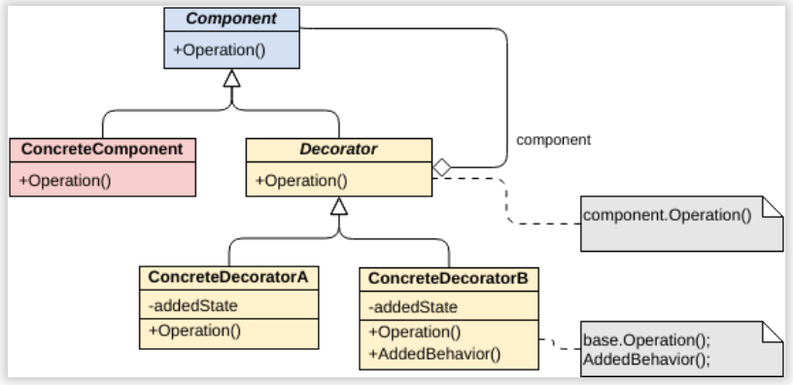
Inheritance is static. You can’t alter the behaviour of an existing object at runtime. You can only replace the whole object with another one that’s created from a different subclass.
Subclasses can have just one parent class. In most languages, inheritance doesn’t let a class inherit behaviours of multiple classes at the same time.
Notes:
Common use cases – sealed classes and legacy code

Slide 11
Simple Factory
Abstracts creation of objects based on given properties

Slide 12
https://refactoring.guru/design-patterns
https://www.dofactory.com/net/design-patterns
https://www.c-sharpcorner.com/UploadFile/bd5be5/design-patterns-in-net/
Head First Design Patterns by Eric Freeman, Elisabeth Robson, Bert Bates, Kathy Sierra

Slide 13
Template Method
defines the skeleton of an algorithm in an operation, deferring some steps to subclasses. This pattern lets subclasses redefine certain steps of an algorithm without changing the algorithm‘s structure.

Slide 14
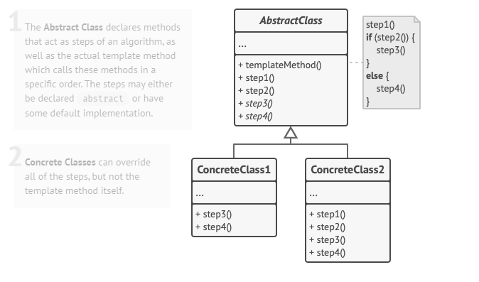
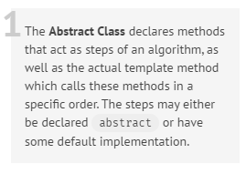
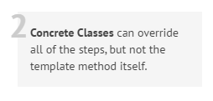
AbstractClass (DataObject)
defines abstract primitive operations that concrete subclasses define to implement steps of an algorithm
implements a template method defining the skeleton of an algorithm. The template method calls primitive
operations as well as operations defined in AbstractClass or those of other objects.
ConcreteClass (CustomerDataObject)
implements the primitive operations to carry out subclass-specific steps of the algorithm

Slide 15
Mediator
defines an object that encapsulates how a set of objects interact. Mediator promotes loose coupling by keeping objects from referring to each other explicitly, and it lets you vary their interaction independently

Slide 16
